Slide 1
Barbuda project sites

Slide 2
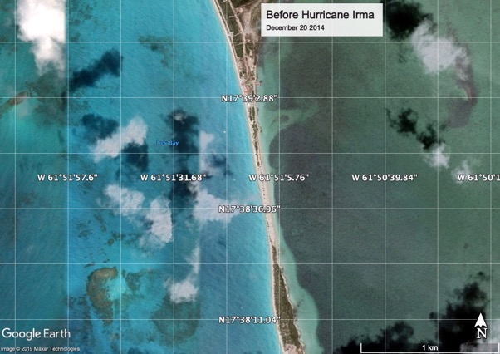

Slide 3
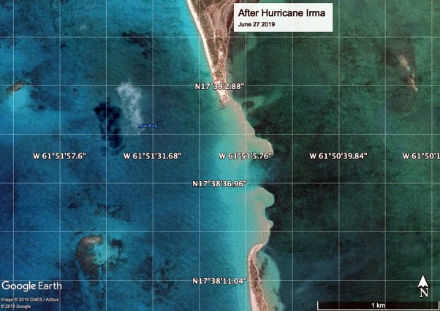

Slide 4
Biorock Anti Wave devices of this shape would be used. The top would be at the high tide mark. Limestone rock will grow over it, and absorb wave energy, trapping sand at the shore.

Slide 5
The Biorock reefs will be installed along the red line to grow back the beach. Power will be provided by floating solar panel arrays in the shallow calm waters of Codrington Lagoon (right). Mariculture projects will be in the lagoon and outside.

Slide 6
